Slide 1
Digital Portfolio
STUDENT NAME: Dharaneesh B N
REGISTER NO AND NMID: BDA84547BDFE2BE95DC41853507DB632
DEPARTMENT: B.SC CT
COLLEGE: KPR College of Arts, Science and Research

Slide 2
Weather APP

Slide 3


AGENDA
Problem Statement
Project Overview
End Users
Tools and Technologies
Portfolio design and Layout
Features and Functionality
Results and Screenshots
Conclusion
Github Link
3/21/2024 Annual Review

Slide 4

PROBLEM STATEMENT
People face difficulty in accessing accurate and real-time weather updates, which affects their daily planning. A weather app solves this by providing instant forecasts, alerts, and climate information in a user-friendly way.

Slide 5

PROJECT OVERVIEW
The weather app project aims to provide users with accurate, real-time weather forecasts and updates. It helps users plan their daily activities by showing temperature, humidity, wind speed, and alerts for extreme conditions. The app ensures a simple, user-friendly interface with reliable data access anytime, anywhere.

Slide 6

WHO ARE THE END USERS?
The end users of a weather app include general people who need daily weather updates for travel, work, or personal planning. It also benefits farmers, fishermen, and outdoor workers who depend on weather conditions for their livelihood. Additionally, travelers and event organizers use it to make safe and informed decisions.

Slide 7

TOOLS AND TECHNIQUES
The weather app uses APIs (like OpenWeatherMap) to fetch real-time weather data. It is developed using tools such as Android Studio, Xcode, or cross-platform frameworks like Flutter/React Native. Techniques like GPS integration, data visualization, and push notifications are applied for better user experience.

Slide 8
POTFOLIO DESIGN AND LAYOUT
The portfolio design and layout of a weather app should have a clean, user-friendly interface with visually appealing graphics. The home screen can display current temperature, weather condition icons, and location details at the top. Additional sections may include hourly/daily forecasts, interactive maps, and a simple navigation bar for easy access to settings, alerts, and saved locations.
8

Slide 9
FEATURES AND FUNCTIONALITY
Real-time Weather Updates – Shows current temperature, humidity, wind speed, and conditions.
Hourly & Daily Forecasts – Provides short-term and long-term weather predictions.
Location-based Services – Auto-detects user’s location and allows saving multiple cities.
User-friendly Interface – Clean design with icons, graphs, and easy navigation.

Slide 10
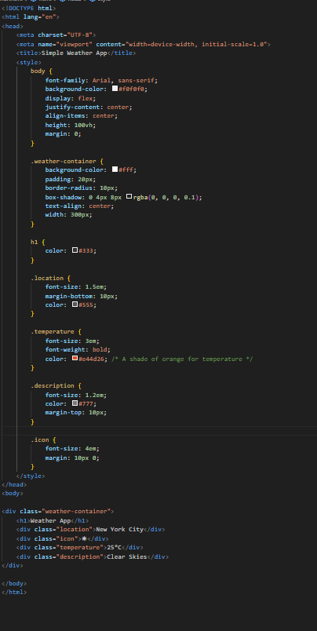
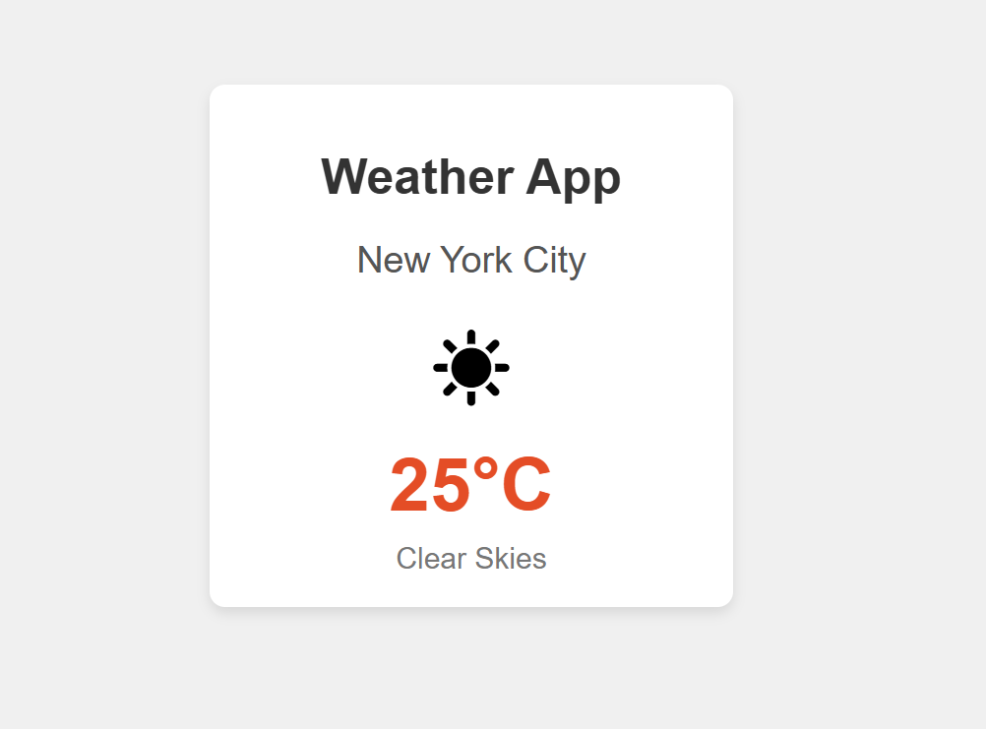
RESULTS AND SCREENSHOTS
3/21/2024 Annual Review
10

Slide 11
CONCLUSION
The weather app provides accurate and real-time weather updates, helping users plan their daily activities effectively. With its simple design and useful features, it ensures safety, convenience, and better decision-making for all types of users.
11

